Slide 1
Financial Aid for New Jersey High School Students and Families 2025-2026 Academic Year Catherine Boscher-Murphy

Slide 2
The Mission
The Higher Education Student Assistance Authority is the only State agency with the sole mission of providing students and families with the financial and informational resources to pursue their education beyond high school.
Higher Education Student Assistance Authority
2
Notes:
HESAA Information Detailed:
Financial aid session
FAFSA Days
Booklets: State and Federal Aid, Financial Aid Dictionary, Student Loan Guide, and Reach Higher the College Planning Booklet.
Handouts: Eight Steps to Apply, Financial Planning Chart, and program brochures are available for free.
REAL $ 101 Financial Literacy on-site Sessions

Slide 3
Financial Aid Application Graduation Requirement: FAFSA, or if applicable NJ Alternative App for NJ DREAMERS or an Approved Waiver
New Jersey high school graduation requirement for students in the graduating classes of 2025,2026 and 2027:
Builds awareness of financial aid resources for New Jersey students to pursue a postsecondary education
Determines eligibility for both federal and state financial aid
Empowers students to make informed decisions about the college selection process
Emphasizes that a college degree is both accessible and affordable for many NJ residents

Slide 4
Goals of Financial Aid Office
Primary goal is to assist students in paying for college and is achieved by:
Evaluating family’s ability to pay for educational costs
Distributing limited resources in an equitable manner
Providing a balance of grants/scholarships and other funds from the family’s own resources and self-help aid (e.g. loans, student employment)
Implementing federal and state regulations for their college/university
Higher Education Student Assistance Authority

Slide 5
What is Financial Aid?
Any/all funds made available to students not paid directly by the family
Higher Education Student Assistance Authority

Slide 6
Types of Financial Aid
Grants
Scholarships
Loans
Employment
Opportunities at school
Sources of Aid
Federal
State of New Jersey
The College/University
Private Scholarships
Civic organizations (ex. local Rotary Club), parent’s employer, high school awards
Sources & Types of Aid
Paying for College with Student/Family Resource
Savings
529 plans
Employee benefits
Higher Education Student Assistance Authority

Slide 7
Types of Aid -
Grants
Gift Aid
Do not have to be repaid
Typically based on a need calculation of some kind
Higher Education Student Assistance Authority

Slide 8
Types of Aid -
Scholarships
Gift Aid
Do not have to be repaid
Typically based on merit or a skill
Academic achievement
Athletic ability
Some talent
Higher Education Student Assistance Authority

Slide 9
Types of Aid -
Student Employment
Offered by the college
Part-time jobs
Paid for hours worked
Not applied to the bill
Higher Education Student Assistance Authority

Slide 10
Types of Aid -
Loans
Borrowed funds must be repaid
Student loans
Parent loans
Private loans
Interest rates and repayment plans differ by program or lender
Higher Education Student Assistance Authority

Slide 11
Sources & Types of Aid
Factors that may influence institutional aid, particularly merit-based aid
Academics
Athletic Ability
SAT or ACT
Geographic Diversity
AP Courses
Legacy (child of alumni)
Activities
Talent (extracurricular or academic)
Gender/Ethnicity
H.S. Attended
Class Rank
Higher Education Student Assistance Authority

Slide 12
Key Eligibility Requirements for Aid
The student must have a valid Social Security Number
Must be enrolled or accepted for enrollment in an eligible program of study at an eligible institution
Must be pursuing a degree, certificate, or other recognized postsecondary credential
Must be a U.S. citizen or eligible noncitizen
Must file the FAFSA
Higher Education Student Assistance Authority
Notes:
If you are an eligible noncitizen, write in your eight- or nine-digit Alien Registration Number. Generally, you are an eligible noncitizen if you are (1) a permanent U.S. resident with a Permanent Resident Card (I-551); (2) a conditional permanent resident with a Conditional Green Card (I-551C); (3) the holder of an Arrival-Departure Record (I-94) from the Department of Homeland Security showing any one of the following designations: “Refugee,” “Asylum Granted,” “Parolee” (I-94 confirms that you were paroled for a minimum of one year and status has not expired), T-Visa holder (T-1, T-2, T-3, etc.) or “Cuban-Haitian Entrant;” or (4) the holder of a valid certification or eligibility letter from the Department of Health and Human Services showing a designation of “Victim of human trafficking.”
If you are in the U.S. on an F1 or F2 student visa, a J1 or J2 exchange visitor visa, or a G series visa (pertaining to international organizations), select “No, I am not a citizen or eligible noncitizen.” You will not be eligible for federal student aid. If you have a Social Security Number but are not a citizen or an eligible noncitizen, you should still complete the FAFSA because you may be eligible for state or college aid.

Slide 13
Types of Aid - Federal
Federal Student Aid for Award Year 2024-25
Pell $7,395 (max award)
SEOG $4,000 (max award)
TEACH $3,772 (max award)
Stafford Direct Student loans ($5,500 for freshmen level)
Parent PLUS loans ( up to COA)
. * 2025-26 award amounts subject to change
Higher Education Student Assistance Authority

Slide 14
In addition to the basic eligibility requirements, students must also:
File a FAFSA or New Jersey Alternative Financial Aid Application
Be a New Jersey resident for 12 months prior to beginning college
Must attend a New Jersey institution
Be enrolled full-time* in an approved degree program
Demonstrate financial need
Meet all state deadlines for application and document submission
*Part-Time TAG, CCOG, and EOF awards are available for county college students enrolled in 6-11 credits per semester.
State Grants & Scholarship Requirements

Slide 15
Types of Aid – NJ State Aid
State of NJ Student Aid for Award Year 2024-25
NJ Tuition Aid Grant (TAG)
Educational Opportunity Fund (EOF)
Comm. College Opportunity Grant (CCOG)
Garden State Guarantee (GSG)
NJ Stars and Stars II
Governor's Urban Scholarship (GUS)
Governor’s Industry Vocation (NJ – GIVS)
NJ CLASS – loan
. * 2025-26 award amounts subject to change
Higher Education Student Assistance Authority

Slide 16
TAG (Tuition Aid Grant)
Awards vary based on what type of college you are attending:
County College = $3098
State Colleges and Universities = $9496
Public Research Universities = $10,964
Independent Colleges = $14,404
* These are annual amounts for 2024-25
Types of Aid: State Grants & Scholarships
Higher Education Student Assistance Authority

Slide 17
EOF (Educational Opportunity Fund)
Award ranges from $200 - $3,050 annually depending on institution
EOF is campus-based and award amounts vary
Must demonstrate educational and economically disadvantaged background
Complete all required EOF tasks with campus EOF Office
Types of Aid: State Grants & Scholarships
Higher Education Student Assistance Authority

Slide 18
Types of Aid: State Grants & Scholarships
Governor’s Urban Scholarship
Rank within the top 5.0% of their class at the end of junior year
Attain a 3.0 GPA at the end of the junior year
Reside in a designated municipality
Qualify for a TAG award
Higher Education Student Assistance Authority
Notes:
EOF (excellent program for financially and economically disadvantaged students)
EOF supports a wide array of campus-based outreach and support services to help program participants succeed and graduate
Must graduate from a traditional public, public charter, county vo-tech or nonpublic school and reside in any of the following townships
GUS - $1,000 annual award – top 5% of HS graduating class
Asbury Park City
Camden City
East Orange City
Irvington Township
Jersey City
Lakewood Township
Millville City
Newark City
New Brunswick City
Paterson City
Plainfield City
Roselle Borough
Trenton City
Vineland City

Slide 19
Types of Aid: State Grants & Scholarships
NJ STARS
NJ residents who rank in the top 15.0% of their class at either the end of junior or senior year of high school
Students must attain a cumulative GPA of 3.0 or higher at the start of the third semester at the county college to remain eligible for NJ STARS
NJ STARS II
Received NJ STARS funding and have a family taxable income of less than $250,000
Must earn an associate degree and graduate with a 3.25 GPA or higher
May receive up to $2,500 annually for a public or private 4-year NJ college or university
Higher Education Student Assistance Authority

Slide 20
Types of Aid: State Grants & Scholarships
Governor’s Industry Vocation Scholarship for Women & Minorities
NJ-GIVS
Up to $2,000 per year for the cost of enrollment at one of New Jersey’s 18 county colleges, technical /vocational schools, some proprietary schools
Benefits women and minorities pursuing certificate or degree programs in construction-related fields
Must be NJ resident and have an AGI < $60,000
Complete separate application online. Found in the student's NJFAMS account, Apply for Scholarships
Some of the programs eligible for the scholarship include
Construction Supervision
Solar Energy Technology
Architectural Engineering Technology
Higher Education Student Assistance Authority

Slide 22
Community College Opportunity Grant (CCOG)
Pays for all or part of the cost of Tuition and Approved fees at a NJ county college
Must take a minimum of six credits per semester
Must make satisfactory academic progress
Available for students in their first and second year of enrollment at a public 2-year institution
Types of Aid: State Grants & Scholarships
Tier I | AGI $0 - $65,000 for maximum award: Tuition & Approved Fees
Tier II | AGI $65,001 – 80,000 for one half of the maximum award at that county college
Tier III | AGI $80,001 - $100,000 for one-third of the maximum award at that county college
Higher Education Student Assistance Authority

Slide 23
Garden State Guarantee
Pays for all or part of the cost of tuition and approved fees at a NJ state college
New Jersey State Colleges and Universities
Must make Satisfactory Academic Progress
Available for students in their third and fourth year of enrollment at a public 4-year institution
Types of Aid: State Grants & Scholarships
Tier I | AGI $0 - $65,000 for maximum award: Tuition & Approved Fees
Tier II | AGI $65,001 – 80,000 pay a net price of no more than $7,500 in tuition and approved fees
Tier III | AGI $80,001 - $100,000 pay a net price of no more than $10,000 in tuition and approved fees
Higher Education Student Assistance Authority

Slide 24
How is CCOG or GSG calculated?
Full-time tuition and mandatory fees minus other grants, scholarships, etc. (not loans or aid designated specifically for housing, books)
Tier 1: Tier 2: Tier 3:
T & F: 14764 14764 14674
Grants: -12000 -7500 * -10000*
GSG: 2764 7264 4674
* Out of pocket by family
Higher Education Student Assistance Authority

Slide 25
3 + 1 Degree Completion Programs
Student completes the first two years at the community college and earns an associate degree
Pays community college tuition and fees for the associate degree and the third year of their bachelor’s degree program
Attends and pays the four-year institution's tuition and fees in the final year of their bachelor’s degree
Must have a complete TAG record to be potentially
eligible for TAG, NJSTARS, and/or CCOG
Burlington CC w/ Rowan, Sussex CC w/ Ramapo, Atlantic CC w/ Rutgers & Stockton
3 + 1 Degree Completion Programs
Higher Education Student Assistance Authority

Slide 26
Financing Solutions & Loans
Monthly Payment Plans – offered by the college
529 Plans
Higher Education Student Assistance Authority

Slide 27
Financing Solutions & Loans
Federal Direct Loan Program (1st year dependent student)
Subsidized Loan $3,500 need based
Unsubsidized Loan $2,000 additional
2024 - 2025 - Federal Undergraduate Direct Loan interest rates are 6.53%, plus a 1.057% origination fee
2025 – 2026 federal rates and fees are subject to change
Higher Education Student Assistance Authority

Slide 28
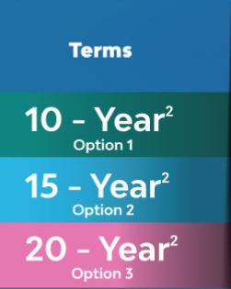
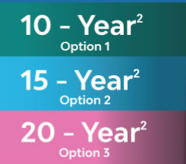
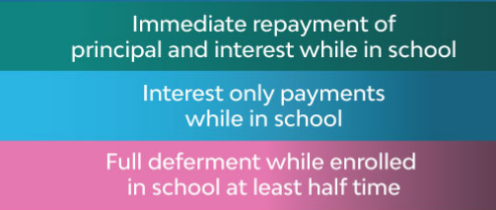
Other Loan Options to Cover the Gap Borrow up to cost of attendance less other aid
2025 – 2026 interest rates will be determined in June 2025
Higher Education Student Assistance Authority

Slide 29
Other Loan Options to Cover the Gap Borrow up to cost of attendance less other aid
Private Loans from Various Lenders
There are many private lenders who will provide loan funds to parents/students
Can be borrowed by any credit-worthy borrower
Does not have to be the parent
Can be the student with a credit-worthy co-signer
Interest rates and repayment plans vary
Higher Education Student Assistance Authority

Slide 30
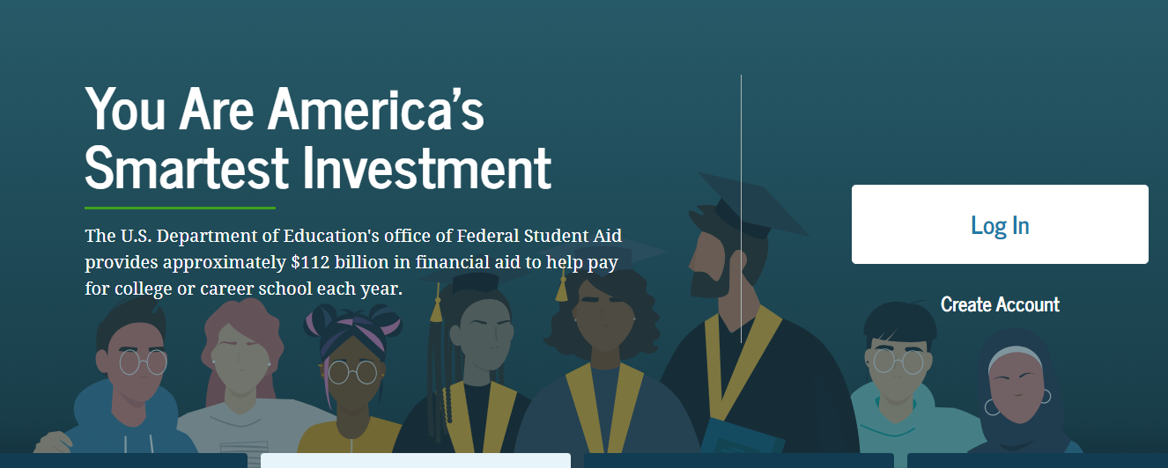
studentaid.gov
FAFSA
Available by December 1, 2024
Applications to Access Aid
student.collegeboard.org/profile
CSS Profile
Available October 1, 2024
HESAA.org
NJ Dreamer
Available by October 1, 2024
Higher Education Student Assistance Authority

Slide 31
CSS Profile
Approximately 400 colleges and organizations use the CSS profile to determine how they will award institutional (school-funded) aid
Some schools are using a Profile Lite to collect basic information due to the concerns surrounding the FAFSA
Available 10/1 each year and collects more comprehensive income, asset, and household information than the FAFSA
Uses prior-prior year income (2023 for 2025-2026)
Mostly used by more elite, high prices, well endowed independent (private) colleges and universities
Register – Complete Application – Make payment – Submit
No application fee for income under $100,000
All others, $25 for first application and $16 for each additional
Higher Education Student Assistance Authority
Notes:
Check out http://student.collegeboard.org/profile for a list of institutions that require CSS profile
CSS profile uses institutional methodology formula whereas FAFSA uses federal methodology
The CSS profile is a fee based application. The cost for filing the CSS PROFILE is $25 for the first college, and there is an $16 processing fee for each additional college. This is not the FAFSA. The FAFSA is free.
Can take 45 minutes to 2 hours to complete
Can leave some answers blank but an error will prompt if answer is required but most numeric questions at least require a zero

Slide 32
CSS Profile
Website to apply for profile
https://cssprofile.collegeboard.org/
Website to apply for Noncustodial Profile:
https://cssprofile.collegeboard.org/profile-for-parents
Participating CSS Institutions:
https://cssprofile.collegeboard.org/profile/ppi/participatingInstitutions.aspx
Customer Support - 844-202-0524 | Live Chat Available
Higher Education Student Assistance Authority
20

Slide 33
Used by every institution (6,000+) who is eligible to process federal financial aid
The 2025-2026 FAFSA is available by December 1, 2024
Collects family’s personal and financial information used to calculate the student’s Student Aid Index (SAI). The SAI determines eligibility for federal student aid
File the FAFSA electronically via FAFSA on the Web at www.studentaid.gov
FAFSA uses prior-prior year income information (2023 for award year 2025-26)
All contributors on the application (student and parent(s)) must provide consent to the IRS to obtain Federal Tax Information (FTI) to populate income and tax information with actual prior-prior year tax information
All prior-prior year tax information (2023) is already filed, allowing immediate retrieval.
Free Application for Federal Student Aid (FAFSA)
Higher Education Student Assistance Authority

Slide 34
2025-2026 Federal Student Aid ID
Student and all Contributors must create a Federal Student Aid ID (FSA ID) at www.studentaid.gov by clicking on “create account”
The FSAID acts as your electronic signature for the FAFSA, federal loan applications every year
Student identifies who the Contributor(s) are and invites them to contribute to the FAFSA. Each contributor must have their own separate FSA ID and password.
Contributors include: Biological Parent, Stepparent, and Adoptive Parent
Who Needs an FSA ID?
If there are two parents who filed taxes jointly, only one parent
If the parents are divorced/separated, the parent who provided more financial support in the last 12 months
If married or unmarried/living together but did not file taxes jointly, then each parent will need an FSA ID
Higher Education Student Assistance Authority
Notes:
The FSA id is a higher security login which will connect the student and parent to the FAFSA. The FSA id will also connect the student to the federal student aid website, and the National student loan data base.

Slide 35
2025-2026 Federal Student Aid ID for Undocumented Contributors
Contributors who do not have an SSN will register with their name, date of birth, permanent address, email address and will have to verify their identity through a knowledge-based verification process
All contributors must be verified by individual email when creating the FSA ID
Information Contributors who cannot verify identity will be able to complete the process of creating their FSA ID account and complete the FAFSA
FSA will send a case number with information to submit documentation to verify identity via email
Higher Education Student Assistance Authority

Slide 36
Federal Tax Information (FTI)
The IRS will request consent to retrieve your Federal Tax Information (FTI) into the FAFSA
If parents are married or unmarried/living together, but did not file taxes jointly, then both will need to login to provide consent to retrieve federal tax information
Higher Education Student Assistance Authority

Slide 37
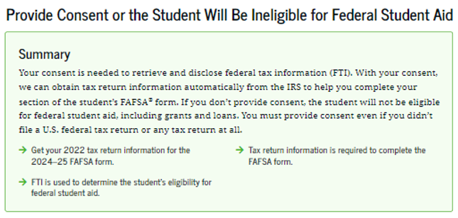
Federal Tax Information Consent
Information Contributors will be instructed to provide Federal Tax Information from their 2023 tax return to be used to determine
the student's eligibility for federal student aid for Award Year 2025-26
2022
Get your 2023 tax return information for the
2025-26 form.
Higher Education Student Assistance Authority

Slide 38
Key Components of the FAFSA
Student Contributor Section
Full Name and address
Social Security Number or ITIN Number
Date of Birth
Mobile phone number (optional)
Email address – not the HS one
College/Career plans – 20 Colleges
Student Consent and Assets
FTI (Federal Tax Information)
Student Status: Personal Circumstances
Dependent or Independent Determination
Student Special Circumstances
Student Unusual Circumstances
Social Security Number
Higher Education Student Assistance Authority

Slide 39
Key Components of the FAFSA
Parent Contributor Section
Last Name
Date of Birth
Email address
Family size – FTI
Income and Assets
Federal Means-tested benefits
Medicaid, SSI, SNAP, Free or Reduced Lunch
TANF, WIC, WITC QHP
Parent Consent and Assets
FTI (Federal Tax Information)
Assets are reported as of the date you are completing the FAFSA
Assets include Cash, savings, checking accounts
Investments = CD’s, money markets, stocks, bonds, property, second home
Business and Farm value
Child support received
DO NOT include:
Retirement account value
Primary home
Pension distributions on the tax return are considered income
A multi-family home is an asset for the portion you do not live in
Higher Education Student Assistance Authority
Notes:
WHO IS THE PARENT
If your parent was never married and does not live with your other legal parent, or if your parent is widowed or not remarried, answer the questions about that parent.
• If your legal parents (biological and/or adoptive) are not married to each other and live together, select “Unmarried and both parents living together” and provide information about both of them regardless of their gender. Do not include any person who is not married to your parent and who is not a legal or biological parent. Contact 1-800-433-3243 for assistance in completing questions 80-94.
• If your parents are married, select “Married or remarried.” Consistent with the Supreme Court decision holding Section 3 of the Defense of Marriage Act (DOMA) unconstitutional, same-sex couples must report their marital status as married if they were legally married in a state or other jurisdiction (foreign country) that permits same-sex marriage, without regard to where the couple resides. If your legal parents are divorced but living together, select “Unmarried and both parents living together.” If your legal parents are separated but living together, select “Married or remarried,” not “Divorced or separated.”
• If your parents are divorced or separated, answer the questions about the parent you lived with more during the past 12 months. (If you did not live with one parent more than the other, give answers about the parent who provided more financial support during the past 12 months or during the most recent year that you actually received support from a parent.) If this parent is remarried as of today, answer the questions about that parent and your stepparent.
• If your widowed parent is remarried as of today, answer the questions about that parent and your stepparent.

Slide 40
FAFSA Submission Summary
All Information Contributors will receive an individual
FAFSA Submission Summary
Applicants are instructed to log into “NJFAMS.HESAA.org” to create a user ID and password. In 3-5 business days, students can their check awards and eligibility status and complete any outstanding items on their “To Do” list (There is no separate State Application, only a To-Do List in the state’s NJFAMS system).
Please note, all notifications will be sent to the student email address listed on the FAFSA.
Higher Education Student Assistance Authority

Slide 41
I Don’t Qualify to Apply with the FAFSA
You may be considered a NJ Dreamer if you are :
a resident who was brought to the United States as a child without documentation and
meets all the criteria outlined next and
are not eligible for financial assistance under the Free Application for Federal Student Aid (FAFSA®)
you may still be eligible for state financial aid through the New Jersey Alternative Financial Aid Application
Higher Education Student Assistance Authority

Slide 42
NJ Dreamers
Eligibility for NJ Alternative Application
Attended a New Jersey high school for at least three (3) years
Graduated from a New Jersey high school or received the equivalent of a high school diploma in New Jersey
Are able to file an affidavit stating that you have filed an application to legalize your immigration status or will file an application as soon you are eligible to do so
Higher Education Student Assistance Authority

Slide 43
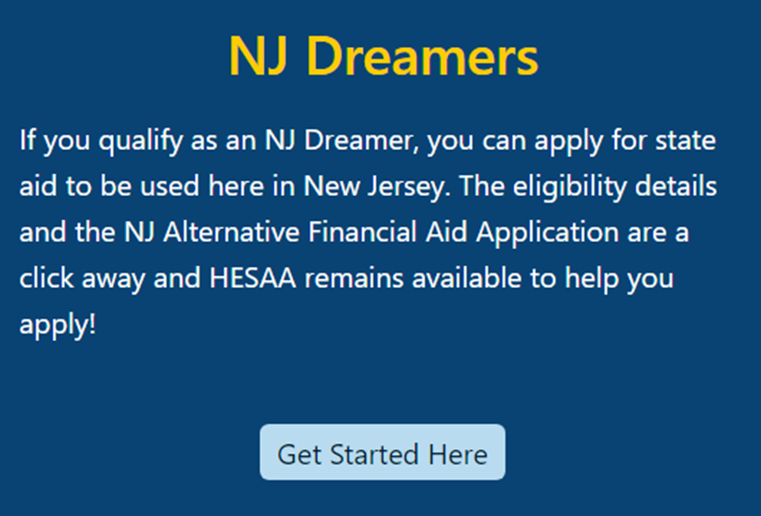
New Jersey Dreamers
Application is part of NJFAMS, at https://njfams.hesaa.org
Register for your account by creating a User ID and Password
Login to complete the application by established deadlines
Must meet all other need and/or merit-based eligibility criteria for State student aid
Higher Education Student Assistance Authority

Slide 44
New Jersey
Financial Aid
Management
System - NJFAMS
All students must go to “NJGRANTS.org”
Establish an NJFAMS Account by creating a User ID and Password
Track the status of your State-funded student aid and respond to required tasks on the To-Do List
Higher Education Student Assistance Authority

Slide 45
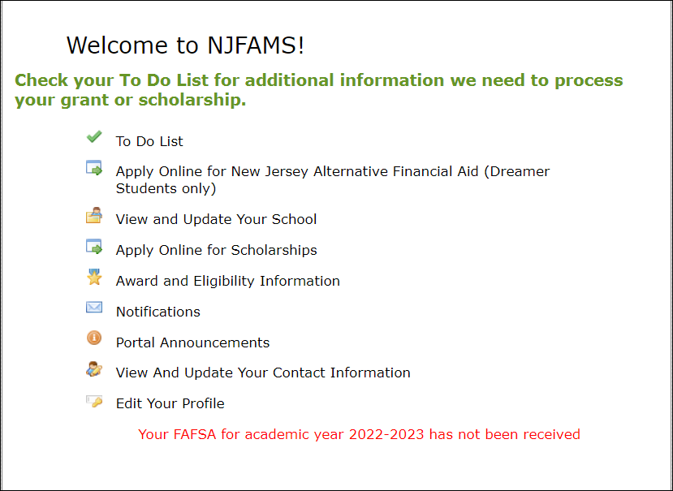
NJFAMS – Menu
Higher Education Student Assistance Authority

Slide 46
Federal & State Verification
School is responsible for verifying information for federal aid except for special circumstances
HESAA is responsible for verifying information for State aid
Schools may send request for information by mail or e-mail
Always check your school account and NJFAMS account for required tasks
Be sure to meet verification deadlines
Higher Education Student Assistance Authority

Slide 47
What Is The Student Aid Index (SAI)?
SAI is determined by a federal formula that calculates federal Pell grant eligibility and is used to determine further financial need using the information you supplied on the FAFSA
SAI and Financial Need are guidelines used by schools to determine student aid offers
Higher Education Student Assistance Authority

Slide 48
Cost of Attendance
Tuition and fees – direct expenses
Food and housing – direct or indirect
Books and supplies, equipment, computer – direct but not billed
Federal Loan Fees - direct
Transportation – indirect
Miscellaneous - indirect
Higher Education Student Assistance Authority

Slide 49
Other Costs
Medical Insurance if required by the school
Study abroad costs
Expenses for cooperative education program
Unexpected costs
Remediation Classes: extra 1 – 2 semesters
Change in major: 1 – 2 years in addition
Transferring: possible extra semester
Unpaid internships: loss of Summer wages
Spring break, trips home, pledging costs
Moving expenses and Summer storage
Higher Education Student Assistance Authority

Slide 50
Federal Pell Grants – Sample SAI for Smith vs Jones Family
The Smith family lives in New Jersey
Married parents filing jointly
Family size of 4
2023 adjusted gross income = $94,002
Assets = $0
Student income / assets = $50 / $213
SAI = 8,667
$0 federal Pell grant eligibility
The Jones family lives in New Jersey
Married parents filing jointly
Family size of 6
2023 adjusted gross income = $94,002
Assets = $0
Student income / assets = $50 / $213
SAI = 3,764
$3,631 federal Pell grant eligibility
SAI Calculator: https://www.collegemoneymethod.com/2024-25-student-aid-index-sai-calculator/
Higher Education Student Assistance Authority
36

Slide 51
Financial Need for Smith Family
College | Community College | State College or University | Private College or University
COA | $8,000 | $30,000 | $60,000
SAI Other Financial Aid | 8,667 1,000 | 8,667 1,000 | 8,667 1,000
Unmet Financial Need | $0 | $20,333 | $50,333
Higher Education Student Assistance Authority
37
Notes:
All examples include approximate tuition, fees (left out new student fee), room and board for academic year.

Slide 52
Net Price Calculator
All institutions must have a net price calculator posted on their websites.
Students will be able to estimate the individual net price per institution.
Based on full-time, first degree/certificate-seeking undergraduate students.
Higher Education Student Assistance Authority
Notes:
HESAA also has on the website the NJEI calculator that calculates TAG for estimate purposes only.

Slide 53
Other Resources
Outside Scholarships
Campus-Administered Payment Plans
Campus Employment (including school-sponsored “work-study” jobs)
Specialized Campus Opportunities
Residential Advisors
Student Ambassadors
Student Tour Guides
Internships/Co-ops
Higher Education Student Assistance Authority

Slide 54
Private Scholarship Search
Institution/college websites
Local library resources
Local businesses, civic organizations and churches
Check with your High School guidance office
Parent’s employer(s)
www.hesaa.org
www.fastweb.com
www.collegeboard.org
www.mappingyourfuture.org
ScholarshipUniverse (at participating schools)
Higher Education Student Assistance Authority

Slide 55
NJBEST 529 College Savings Plan
HESAA awards a one-time scholarship ranging from $2,000 - $6,000 to NJBEST beneficiaries who enroll in a New Jersey institution after making contributions to an account for at least 4 years
NJBEST offers a matching grant up to $750 for new accounts
State tax deduction for up to $10,000 in annual contributions to an account To Learn More: https://www.hesaa.org/pages/NJBESTHome.aspx
Higher Education Student Assistance Authority

Slide 56
Where Do I Go From Here?
Obtain and review admission, financial aid materials and deadlines from each school to which you are applying
Meet all application deadlines
CSS Profile if applicable – check college website
Complete the FAFSA and any other application materials required by the school or your state agency
NJ State deadlines for high school Class of 2025:
September 15, 2025 for Fall ‘25 and Spring ‘26 semesters and February 15, 2026 for Spring ‘26 ONLY awards
April 15, 2026 to renew your financial aid for Academic Year 2026-27
Note: After 1st year, students must renew ANNUALLY by April 15th e.g., April 15, 2026 for sophomore year, if the student received a State TAG award in the current year)
Higher Education Student Assistance Authority

Slide 57
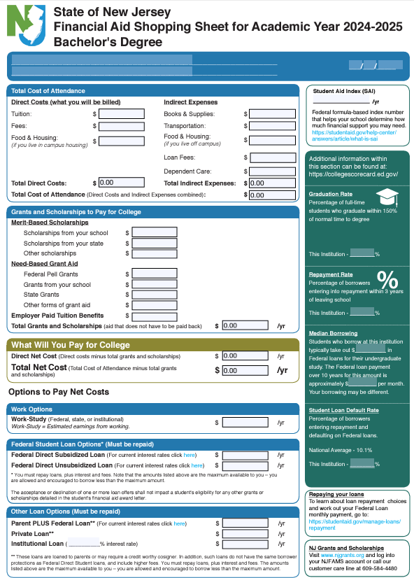
The College Financing Plan New Jersey Shopping Sheet
Help families with net cost transparency
Separates the Cost of Attendance listing the direct and indirect costs
Grants and Scholarships (no repayment required, “free money”)
Student Net Costs in center box
College coordinated work-study employment
Federal Student Loans
If necessary, alternate loans
Aid Offer must replicate the Shopping Sheet
Higher Education Student Assistance Authority

Slide 58
Comparing Offers
Look at the bottom line
Direct expenses minus grant aid
Direct expenses minus grant and student loans
How much can you afford?
A more expensive school can actually cost less
Higher Education Student Assistance Authority

Slide 59
Consumer Issues
Renewability of merit aid
Minimum GPA?
Need-based aid
Will changes in need from year to year cause an adjustment?
Treatment of outside scholarships
Reduce loans or institutional aid
Aid Notifications - review them carefully
Scholarship scams
Consultants - good or bad idea?
Higher Education Student Assistance Authority

Slide 60
Special Circumstances
Significant change to family situation
Loss of Income
Retirement, unemployment, company closing
Separation/divorce of parents
Death/disability of parent
Every school treats these differently
Federal regulations allow lots of leeway
Different rules for NJ Grants too
Higher Education Student Assistance Authority

Slide 61
The Cycle of Financial Aid
December - March | Complete FAFSA application (Available December 1st for 2025-26), college search, college application process, and CSS Profile
February - May | Schools send financial aid offers
June - July | Schools send Fall semester bills
August | Bills are due
Higher Education Student Assistance Authority

Slide 62
Apply for State Aid Workshops & Webinars
Live Webinars
The 2025-2026 Free Application for Federal Student Aid (FAFSA®) opens by December 2024.
Most colleges and universities provide FAFSA® Completion Workshops to assist families with completing the FAFSA® application. For FAFSA® Virtual Workshops dates please check your local high school or college. You are also invited to join one of HESAA’s virtual events.
Pre-recorded Webinars
Higher Education Student Assistance Authority

Slide 63
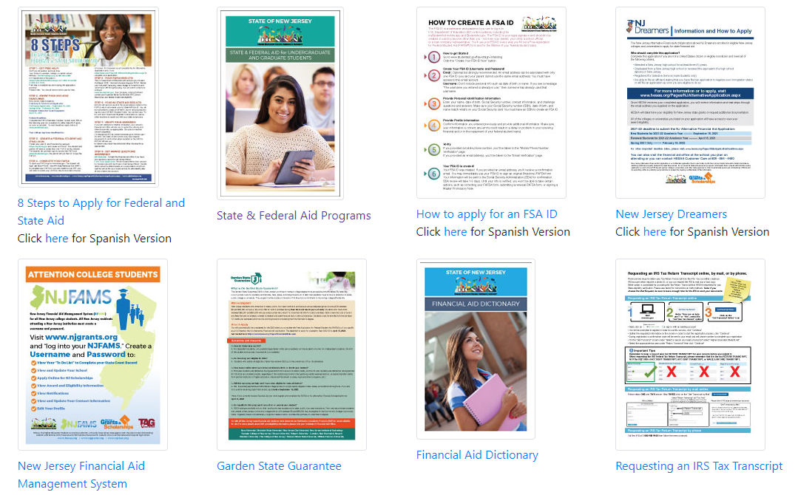
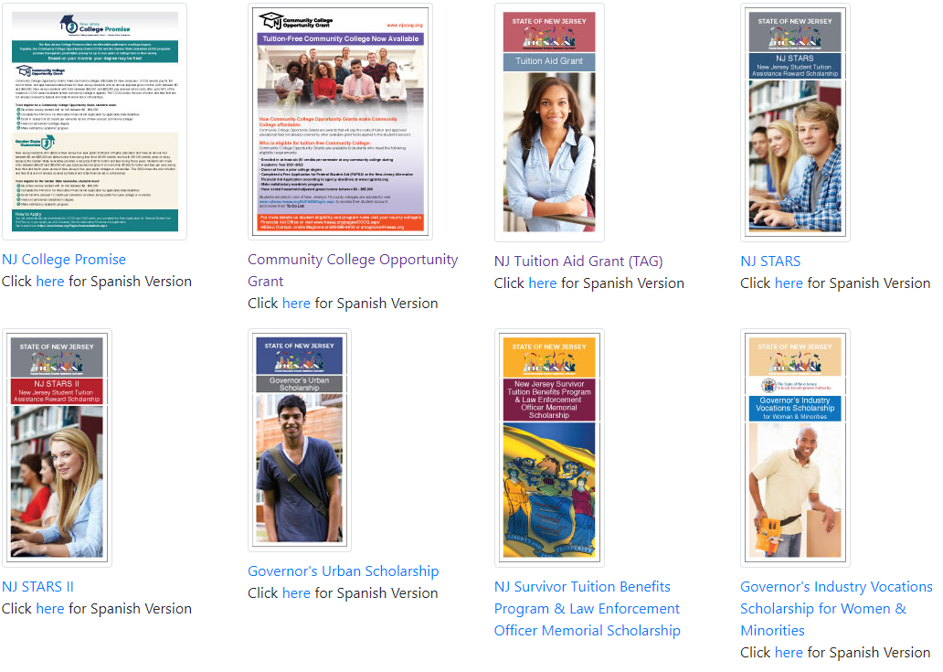
Publications
Higher Education Student Assistance Authority

Slide 64
HESAA Services
Customer Care Center
CustomerCare@hesaa.org
609-584-4480
Monday – Thursday: 8:30 – 8 and Friday: 8:30 – 5:00
Online Resources
www.hesaa.org
www.njgrants.org
www.njclass.org
https://njfams.hesaa.org
www.hesaa.org/pages/financialaidhub
Higher Education Student Assistance Authority

Slide 65
QUESTIONS?
Thank you
Higher Education Student Assistance Authority

